Slide 1

Page 01
AI Implemented ECG-Based Cardiovascular Disease Diagnosis System
An end to end deep learning based pipeline that integrates multiple models through Ensembling technique to diagnose an ECG signal.
BY : TEAM SUPER 4
J. SUSHEEL RAM
K. SAI SRI RAM
D. MANOHAR
K. VAMSISWAR

Slide 2




The Devastating Reality of Cardiovascular Disease
Page 02
CVD deaths have surged from 12.1 million in 1990 to 20.5 million in 2021—a staggering 69% increase
CVD continues to claim 20 million lives annually. In the India alone, Roughly 2.9 million Indians died from CVD in 2021—meaning the nation loses one life every 11 seconds to heart or blood-vessel disorders.

Slide 3



Page 03
The Diagnostic Dilemma: Where Medicine Fails Its Patients
Diagnostic errors affect approximately 5-14% of patients in healthcare settings, with cardiovascular conditions representing one of the three leading categories of harmful misdiagnosis in primary care.
Case Study One: The Healthy Athlete's Silent Killer
AI system capable of analyzing ECG patterns, exercise responses, and genetic markers might have identified the risk factors
Case Study Two: The Misdiagnosed Emergency
An AI system trained of similar presentations could have immediately flagged the combination of symptoms as high-risk for acute coronary syndrome, recommended appropriate cardiac biomarkers and imaging, and prevented this tragic outcome

Slide 4


Approach For The Problem Statement
Page 04
These cases illustrate the three fundamental vulnerabilities that make cardiovascular disease so devastating despite our advanced medical capabilities:
The Asymptomatic Presentation Challenge
The Diagnostic Accuracy Problem
The Time-Critical Nature of Cardiac Emergencies
The Promise of AI in Cardiovascular Medicine
AI-powered diagnostic systems can detect subtle ECG changes, genetic risk factors, and patterns beyond human observation, enabling early detection. Trained on diverse populations, they offer consistent, unbiased support and deliver instant analysis, significantly reducing delays.
Our Solution:
The Transformative Potential of Ensemble AI Solutions

Slide 5


Model`s Description
Page 05
We have employed a pipeline that contains a stack of three ensembled models individually trained on different datasets and formats, this ensembling optimize and maximize diagnostic robustness. Pipeline is curated to take an image of a 12-lead ECG signal and is able to diagnose 13 different categories of CVD's.
The stack of models are curated to process an 187 array point representation of the ECG signals making the models maintain homogeneity.
Why Only ECG
Universal Accessibility and Cost-Effectiveness
Early Detection of Silent and Dynamic Cardiac Events
Scalability and Integration With Wearables and Telemedicine

Slide 6
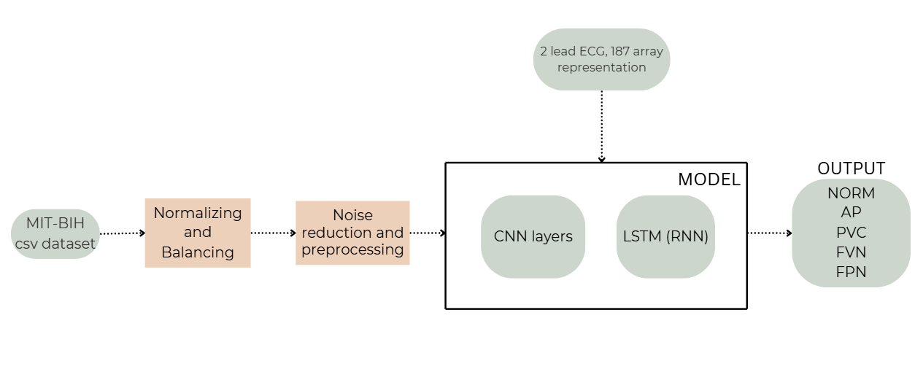
Model - 1 And Its Architecture
Page 06

Slide 7
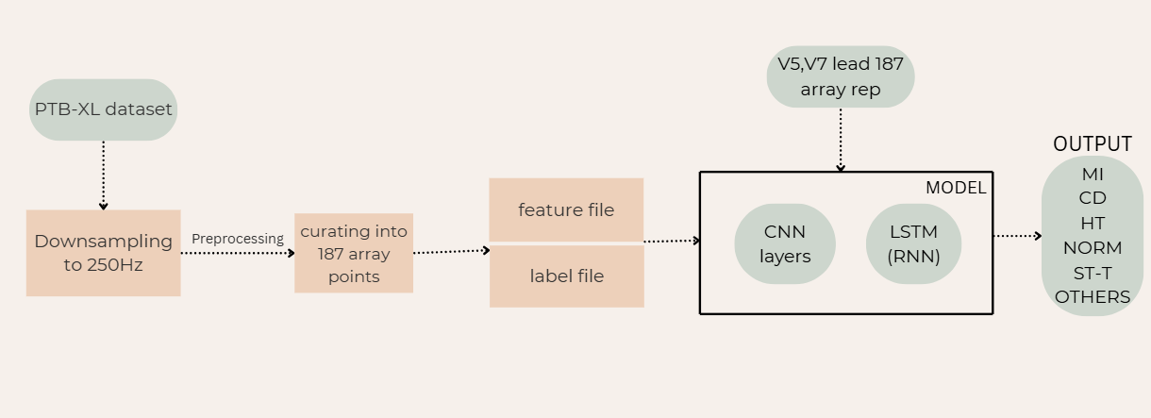

Model 2 And Its Architecture
Page 05

Slide 8

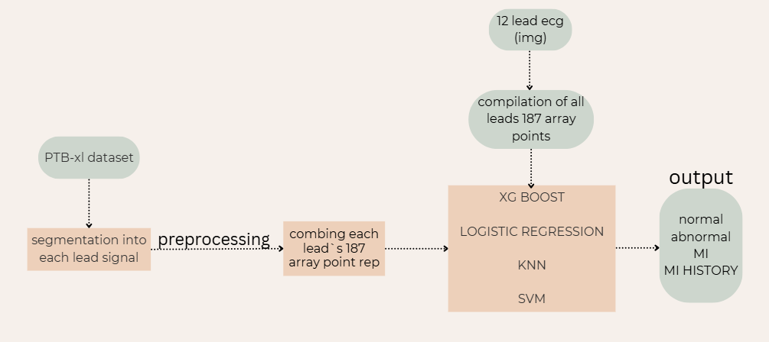


Model - 3 And Its Architecture
Page 07

Slide 9

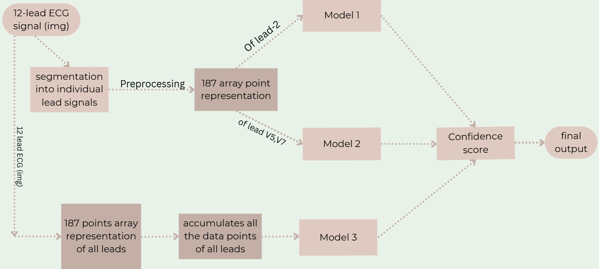

Pipeline And Its Architecture
Page 08
The multi-model ensemble enhances detection of fleeting or low-signal features in ECGs that traditional interpretation misses, enabling population-scale screening and automated follow-up flags for wearable and at-home monitoring devices.

Slide 10

Page 09
Detectable Cardiovascular Diseases
Atrial Arrhythmias(M-I)
Normal
Atrial Premature
Fusion Paced Normal
Ventricular Arrhythmias (M-I)
Fusion Ventricular Normal
Premature Ventricular Contractions (PVC)
Ischemic Conditions (M-II)
ST - T - Change
Normal
Myocardial Infarction (MI)
Conduction Disturbance
Hypertrophy
Others
Other Mayocardinal Infraction(M-III)
Normal
Abnormal
MI
History MI

Slide 11

System Performance & Evaluation
Page 10
Our AI-driven ECG diagnosis system delivers robust performance, validated by rigorous evaluation metrics and optimized for efficient operation in clinical environments.
Unrivaled Diagnostic Accuracy
The system consistently achieves high performance across key metrics:
Accuracy: 85-95%
F1 Score & ROC-AUC: >0.9
Atrial Fibrillation (AFIB) Detection: >98%
Ventricular Tachycardia (VT) Detection:>92%

Slide 12
Page 11
Challenges
Potential Use Cases
Decision Support for Personalized Treatment
Reducing Diagnostic Errors in Outpatient and Primary Care Settings
Rural and Remote Telemedicine Diagnosis Hub

Slide 14


Conclusion.
Future Enhancements
Page 12
Clinical Integration
Edge & Wearables
Larger Datasets
Improved Transformers

Slide 15

Key References
Page 13
PhysioNet: Comprehensive physiological waveform databases for research.
WHO Statistics: Global health data on cardiovascular diseases.
Deep Learning for Time Series Analysis: Foundational research and methodologies applied to sequential data.
Project Repository
Access the full codebase, documentation, and further details of the project on our GitHub repository:
https://github.com/SAISriram19/cardiovascular-super4
WE`RE READY FOR QnA
You
Thank

